Slide 1
Deep Neural Network
Dr. Monali Mavani

Slide 2

Deep Neural Network
Disclaimer and Acknowledgement
The content for these slides has been obtained from books and various other source on the Internet
I here by acknowledge all the contributors for their material and inputs.
I have provided source information wherever necessary
I have added and modified the content to suit the requirements of the course

Slide 3
Session Agenda
Power of MLP
FFNN
Multiclass classification
Softmax operation
Forward propagation

Slide 4
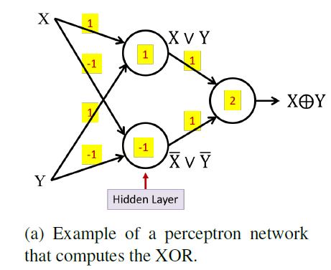
XOR using MLP

Slide 5
Power of MLP
MLP is called as Universal Approximator
Universal Approximation Theorem, formally proven by Cybenko (1989)
A feedforward neural network with a single hidden layer containing a finite number of neurons can approximate any continuous function on a compact subset of ℜ_{n} provided the activation function is non-constant, bounded, and continuous

Slide 6
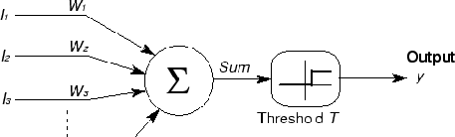

A Perceptron decision boundary
x₁
x₂
1
x₃
x
0
w₁ x₁ + w₂ x₂ = T
2
x₁
x_{N}
i i
i
x₂
x₁
– This is a linear classifier

Slide 7
Composing complicated “decision” boundaries
x
Can now be composed into “networks” to compute arbitrary classification “boundaries”
2
x₁
Build a network of units with a single output that fires if the input is in the coloured area

Slide 8
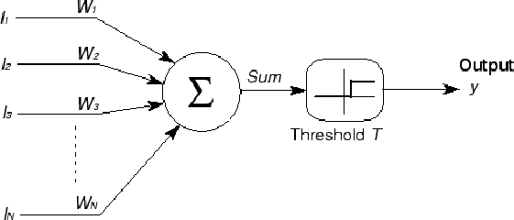
Composing complicated “decision” boundaries
x₂
x₁
x₂
x₁
The network must fire if the input is in the coloured area

Slide 9
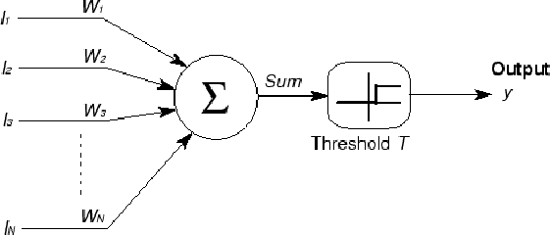
Composing complicated “decision” boundaries
x₂
x₁
x₂
x₁
The network must fire if the input is in the coloured area

Slide 10
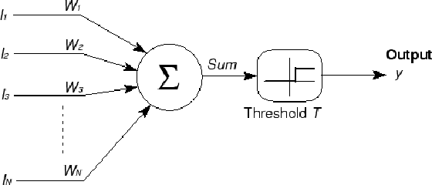
Composing complicated “decision” boundaries
x₂
x₁
x₂
x₁
The network must fire if the input is in the coloured area

Slide 11
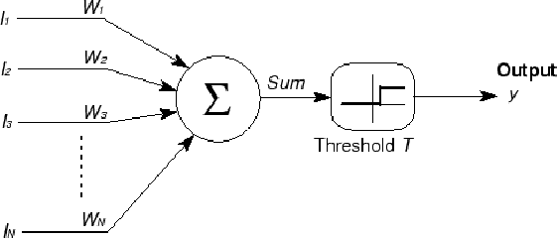
Composing complicated “decision” boundaries
x₂
x₁
x₂
x₁
The network must fire if the input is in the coloured area

Slide 12
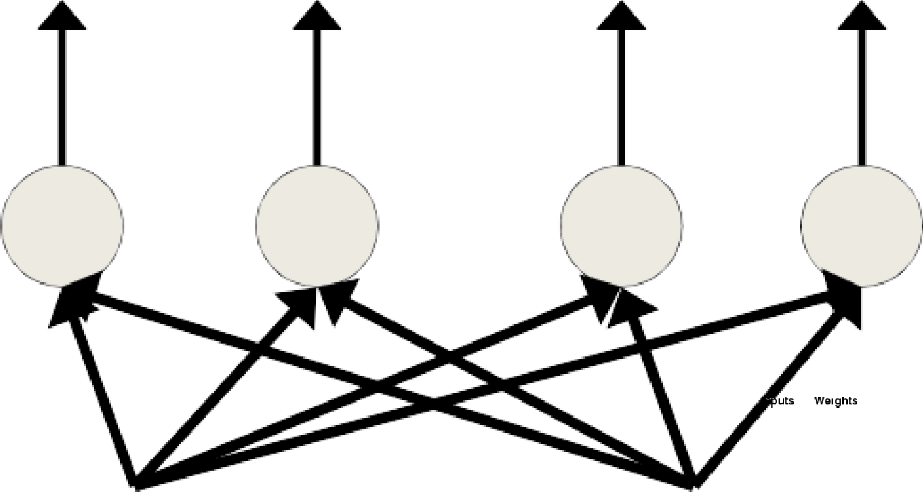

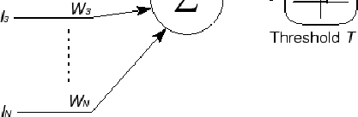
Composing complicated “decision” boundaries
x₂
x₁
x₂
x₁
The network must fire if the input is in the coloured area

Slide 13
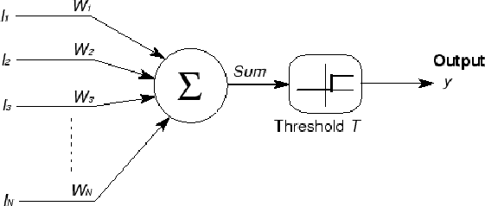
Composing complicated “decision” boundaries
3
N
x₂
i
4
i=1
AND
4
3
3
5
y₁ y₂ y₃ y₄ y₅
4
x₁
4
3
3
4
x₂
x₁
The network must fire if the input is in the coloured area

Slide 14
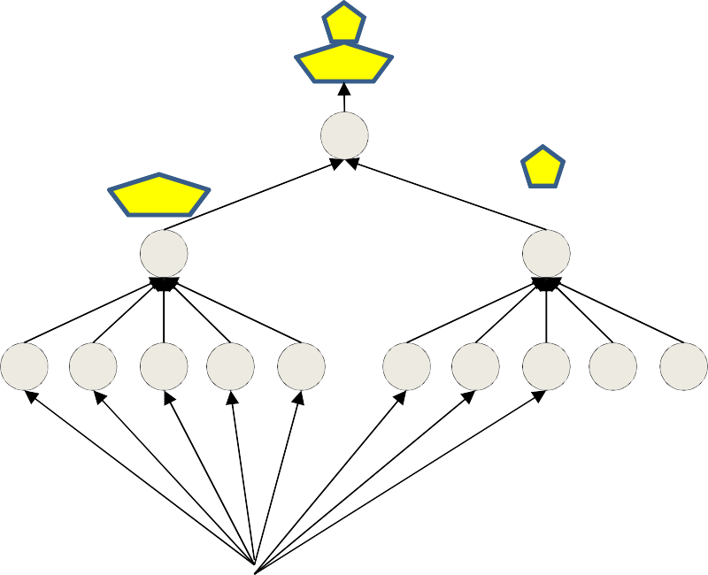
More complex decision boundaries
Non Convex decision region
OR
AND
AND
x₂
x₁
x₁ x₂
Network to fire if the input is in the yellow area
“OR” two polygons
A third layer is required

Slide 15
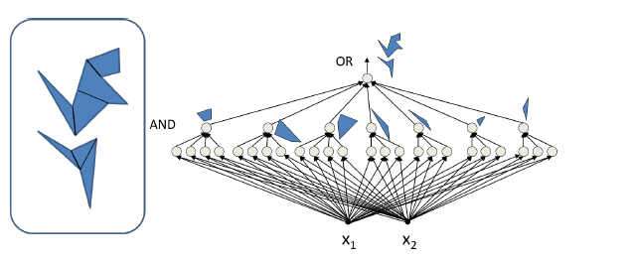
More complex decision boundaries

Slide 16
What is Non-Linearity?
Definition
A function f is non-linear if it does not satisfy the linearity property:
f (ax₁ + bx₂) ≠ a f (x₁) + b f (x₂)
(3)
for all scalars a, b and inputs x₁, x₂.
Why non-linearity matters:
Without non-linearity, deep networks collapse to single-layer models Non-linear activations enable learning complex patterns
Deep Learning

Slide 17
Deep Feed-Forward Neural Network (DFNN)
Definition
A DFNN is a neural network with one or more hidden layers between input and output layers, where information flows forward through non-linear transformations.
Complete system requires four components:
Data: Input features and target outputs
Model: Multi-layer architecture with non-linear activations Objective Function: Loss function to minimize
Learning Algorithm: Backpropagation with gradient descent
1
2
3
4
This is the same framework as linear models, but with added depth and non-linearity!
Deep Learning

Slide 18
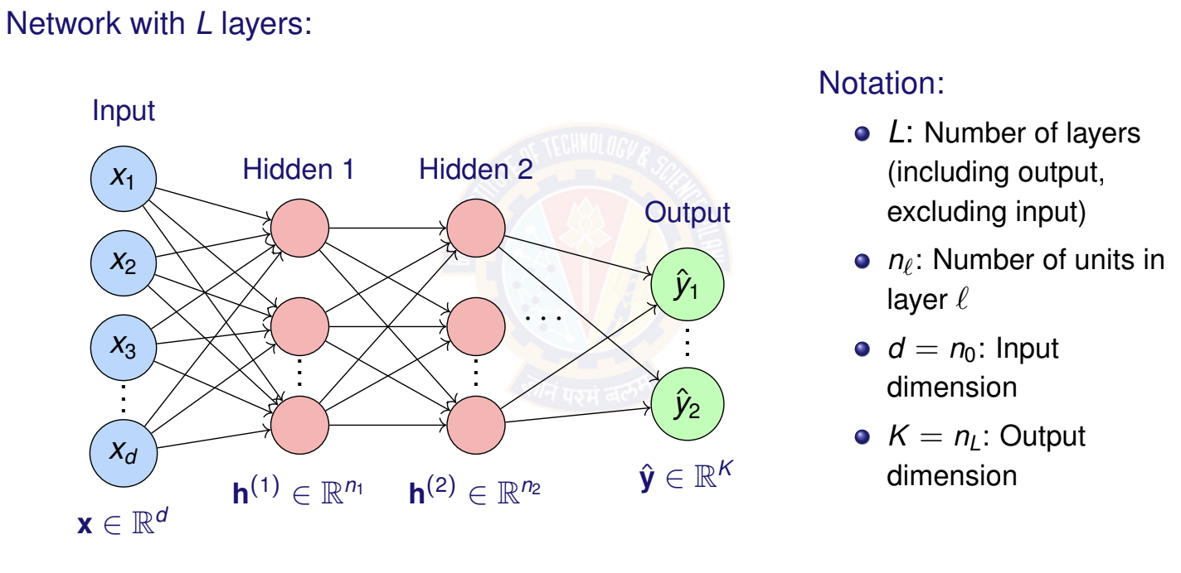
DFNN Architecture
Deep Learning

Slide 19
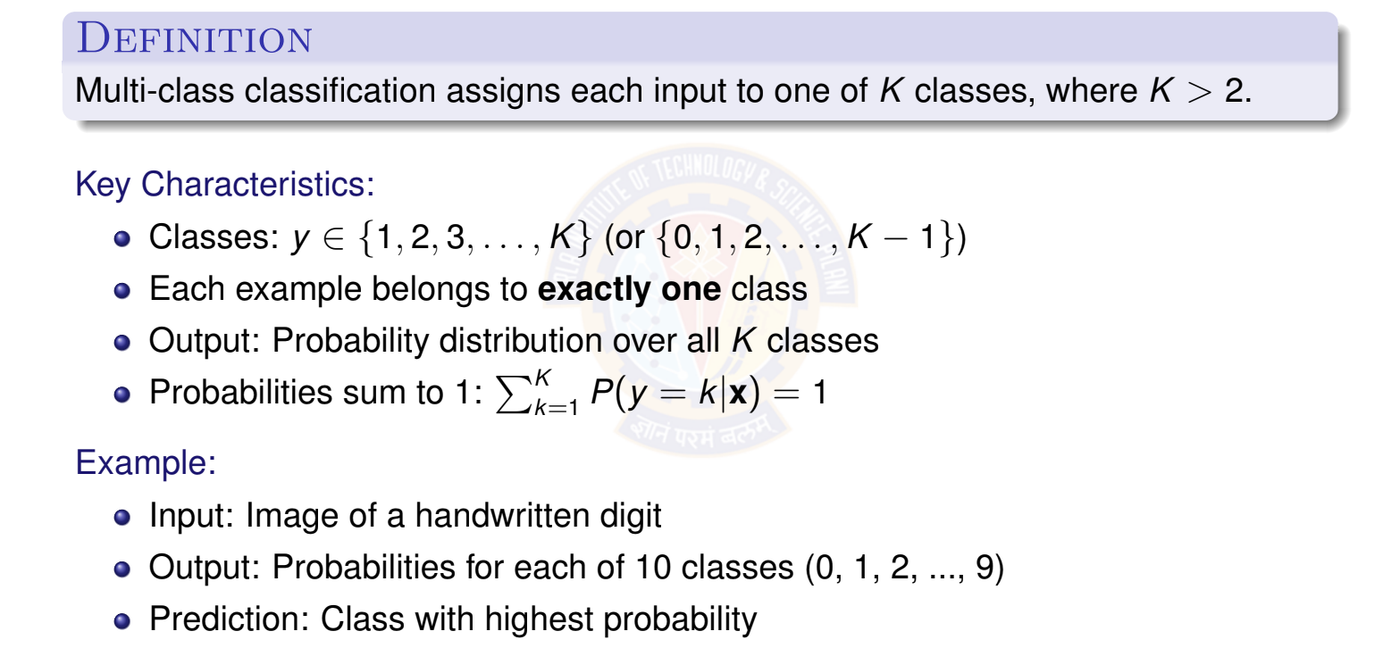
What is Multi-class Classification?
Deep Learning

Slide 21
Examples of Multi-class Classification
Handwritten Digit Recognition (MNIST)
Input: 28 × 28 pixel image
Output: One of 10 digits (0-9)
Image Classification (ImageNet)
Input: Color image
Output: One of 1000 object categories (cat, dog, car, plane, ...)
Text Classification
Input: News article text
Output: Topic category (politics, sports, technology, entertainment, business)
Speech Recognition
Input: Audio features
Output: Phoneme class (multiple phonemes in a language)
1
2
3
4
Deep Learning

Slide 22
Multi-class Classification: Visual Example
x₂
Class 1 Class 2
1
2
1
2
1
2
Key insight: We need
multiple output neu- rons (one per class) and a way to convert their outputs into a valid probability dis- tribution.
1
2
2
1
3
3
3
3
3
Class 3
x₁
Decision boundaries separate K = 3 classes in feature space.
Deep Learning

Slide 23
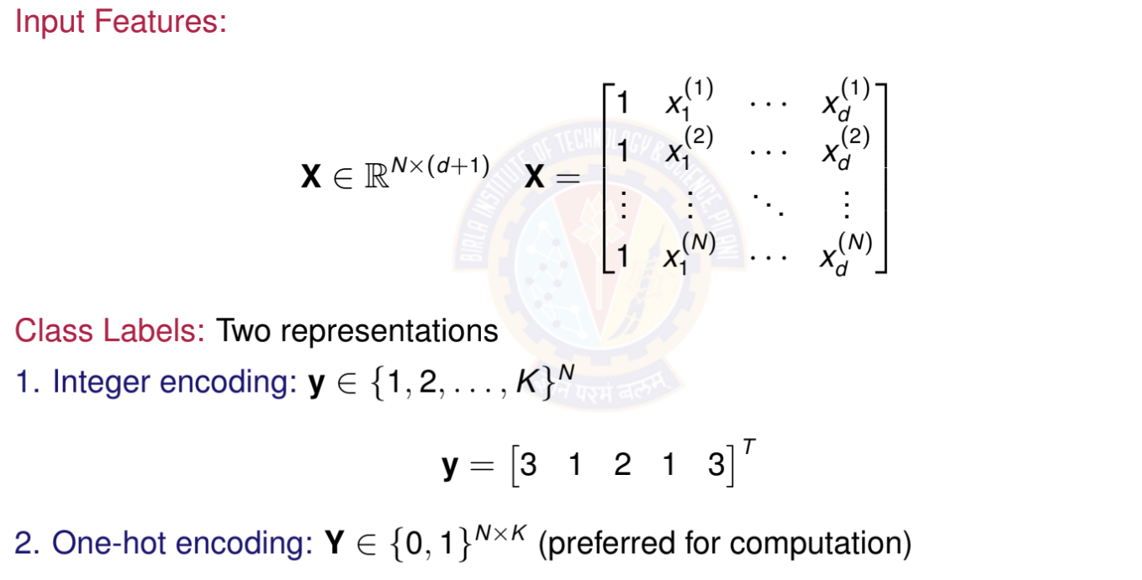
Data Representation
Deep Learning

Slide 24
One-Hot Encoding
Definition: Convert class label to binary vector of length K
For class k : All zeros except 1 at position k
Example with K = 4 classes:
Class 1: y = [1, 0, 0, 0]^{T}
Class 2: y = [0, 1, 0, 0]^{T}
Class 3: y = [0, 0, 1, 0]^{T}
Class 4: y = [0, 0, 0, 1]^{T}
Why one-hot?
Treats all classes equally (no implicit ordering) Matches the format of softmax output probabilities Simplifies loss computation
Standard in deep learning frameworks
Deep Learning

Slide 25
Multi-class Classification Example
Input (x): A 2 X 2 grayscale image
Assume pixels are scalars (0-255)
flattened the image into a feature vector of 4 inputs = [x1, x2, x3, x4]
Example values (normalized): x = [0.9, 0.1, 0.2, 0.8]
Classes (y): 3 categories
Class 1: Circle
Class 2: Square
Class 3: Triangle
One-Hot Encoding:
Circle = [1, 0, 0]
Square = [0, 1, 0]
Triangle = [0, 0, 1]

Slide 26
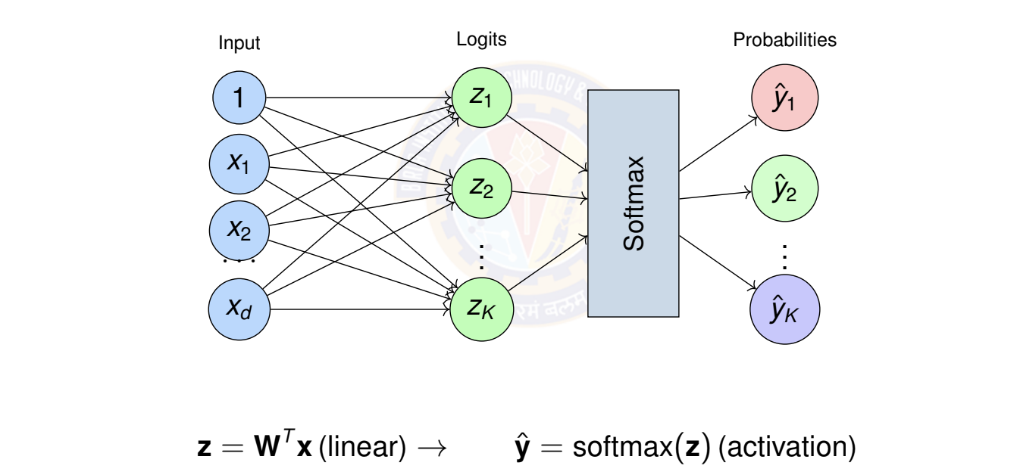
Multi-class Model Architecture
Architecture: Multiple output neurons with softmax activation
Deep Learning

Slide 27
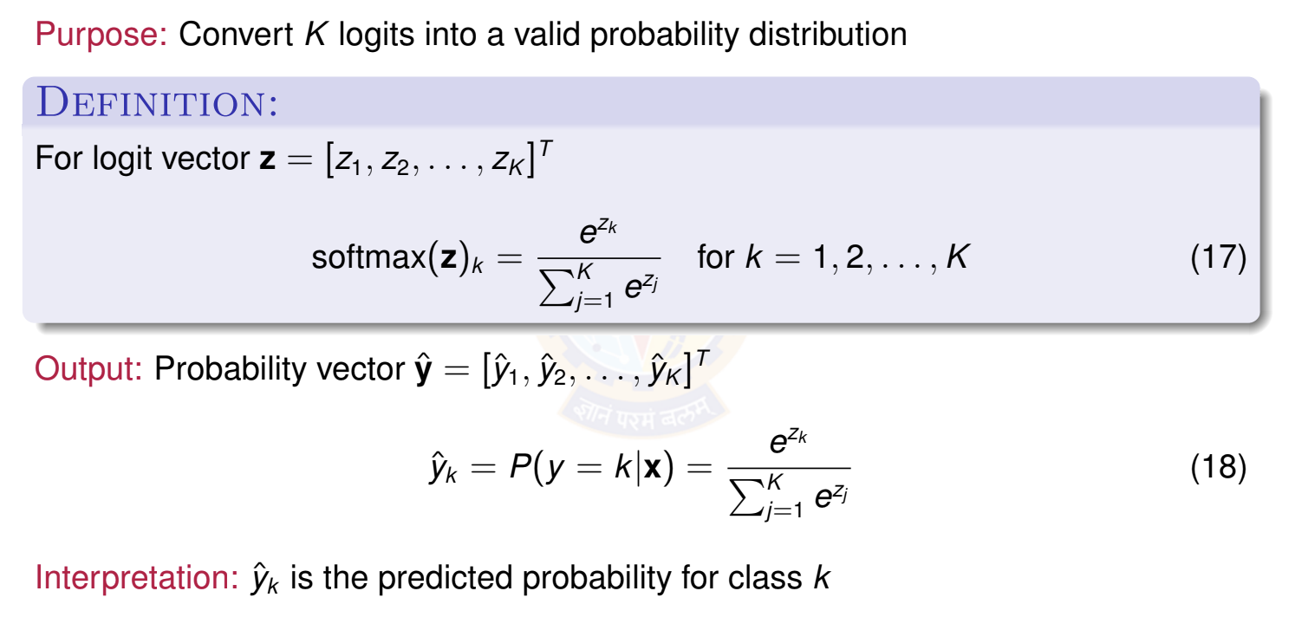
The Softmax Function
Deep Learning
57 / 100

Slide 28
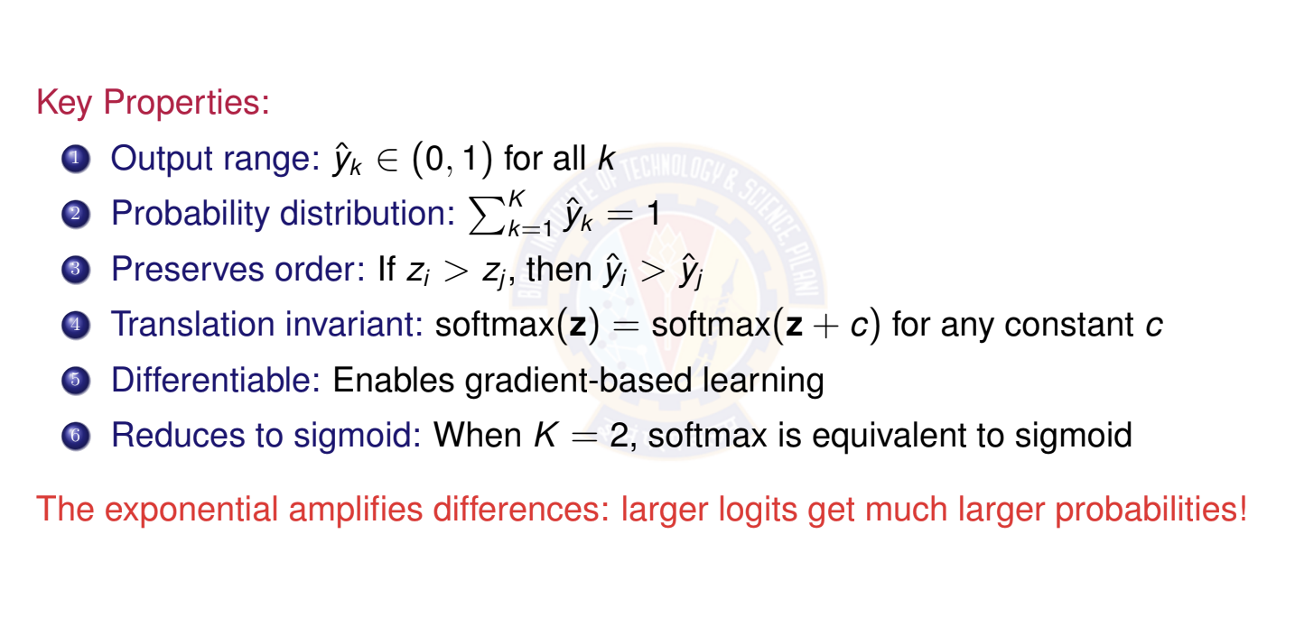
Properties of Softmax
Deep Learning

Slide 29
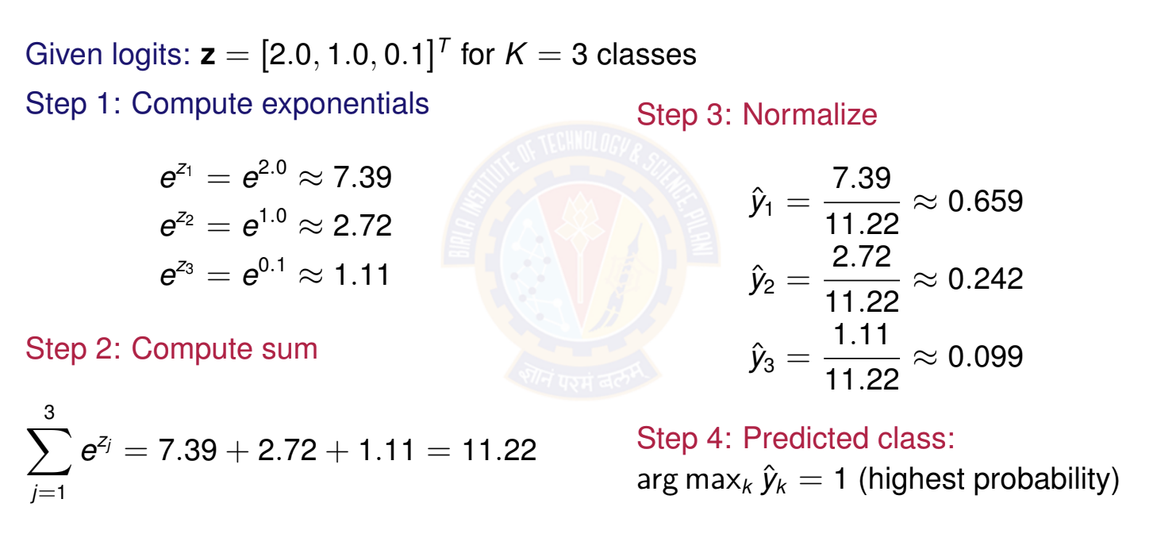

Softmax Example: Numerical Computation
Deep Learning

Slide 30
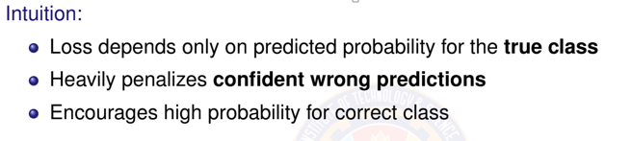
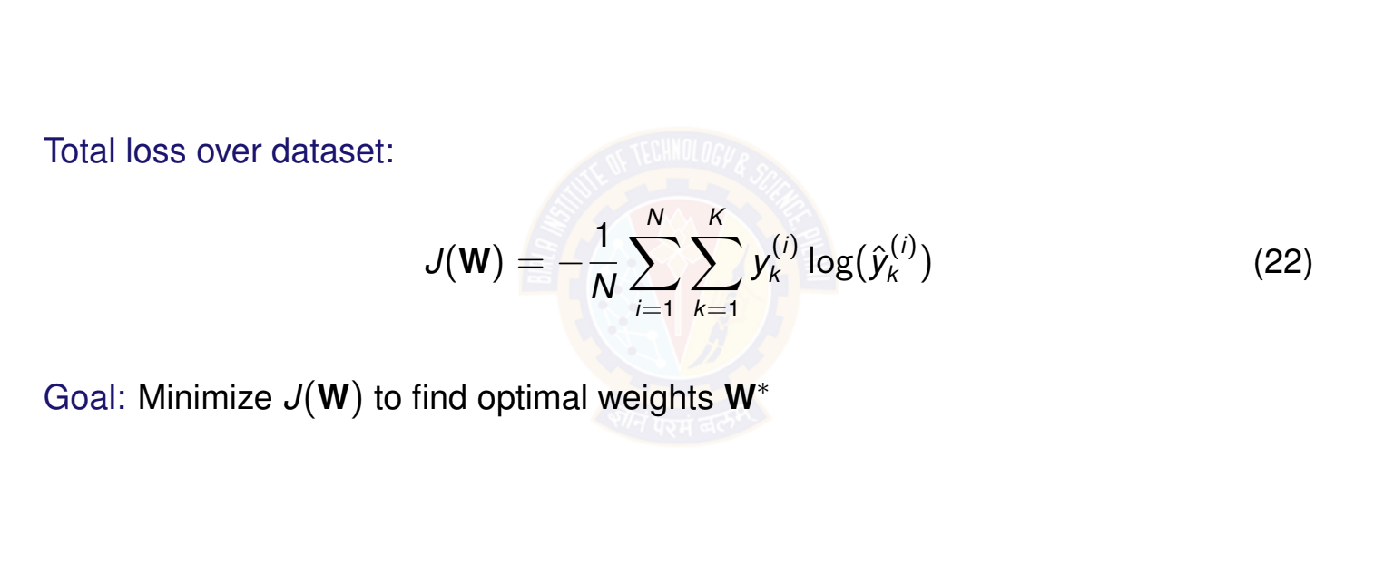
Categorical Cross-Entropy Loss
Deep Learning

Slide 31


Example: one sample
Y-hat = [0.13, 0.87, 0.00]
If the correct class is class 2 in a 3-class problem: y=[0,1,0]
So the sum becomes:
Therefore, for one hot encoded labels :

Slide 32
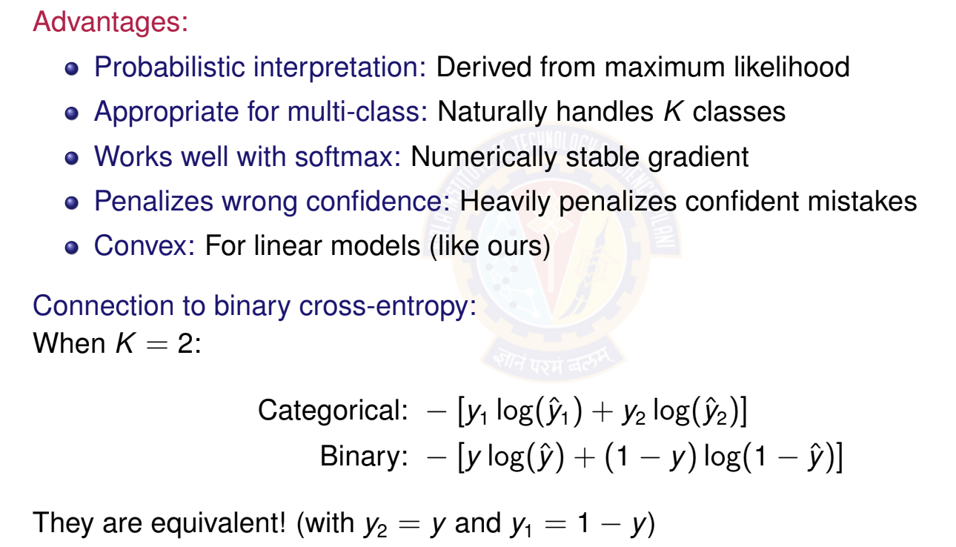
Why Categorical Cross-Entropy?
Deep Learning

Slide 33
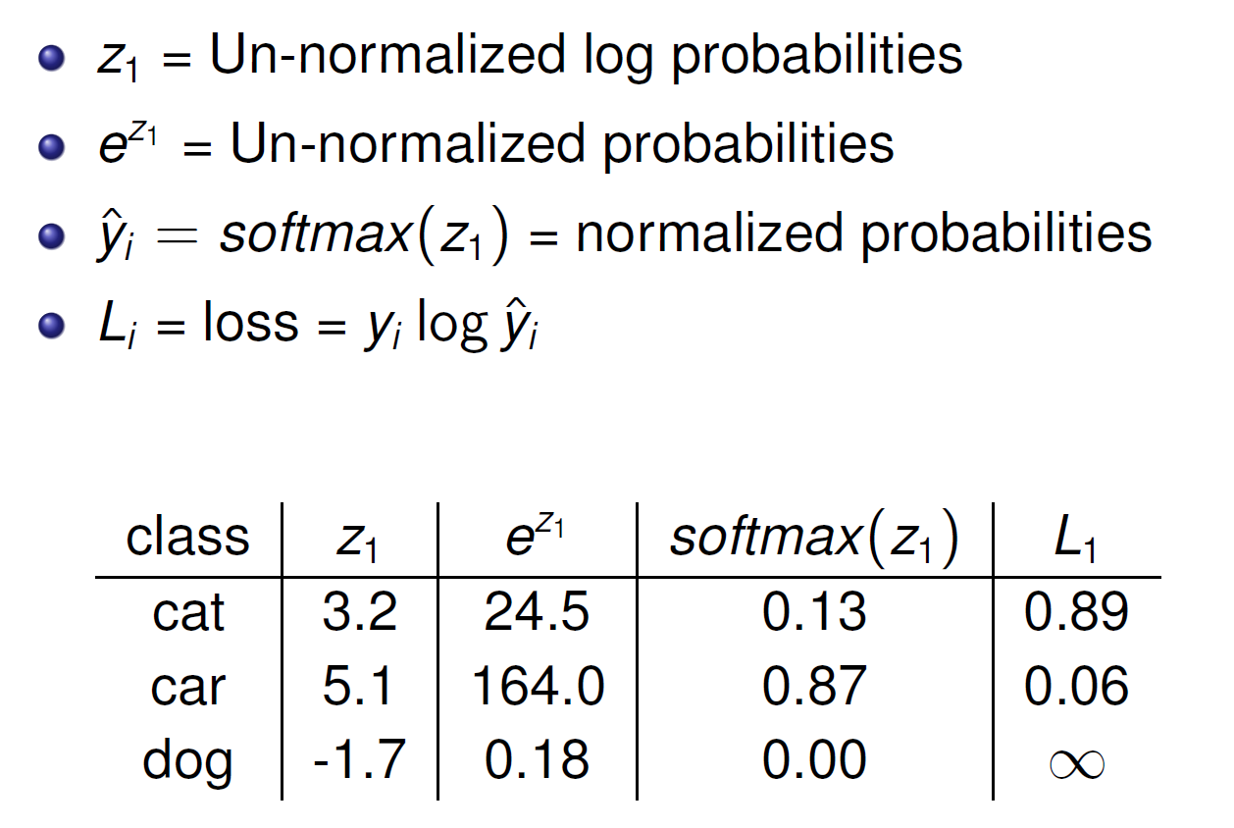
Softmax + loss Example

Slide 35
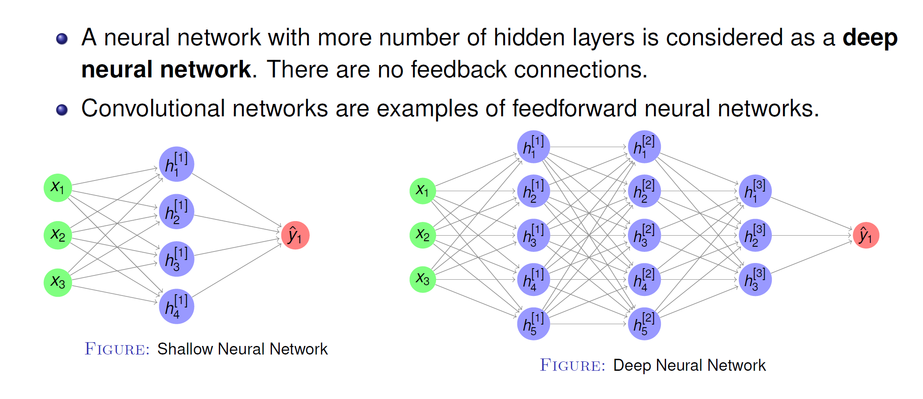
Deep Feedforward Neural Networks

Slide 36
The Flow of Computations in Neural Networks
The flow of computations in a neural network goes in two ways:
Left-to-right: This is referred to as forward propagation, which results in computing the output of the network
Right-to-left: This is referred to as back propagation, which results in computing the gradients (or derivatives) of the parameters in the network
The intuition behind this 2-way flow of computations can be explained through the concept of “computation graphs”

Slide 37
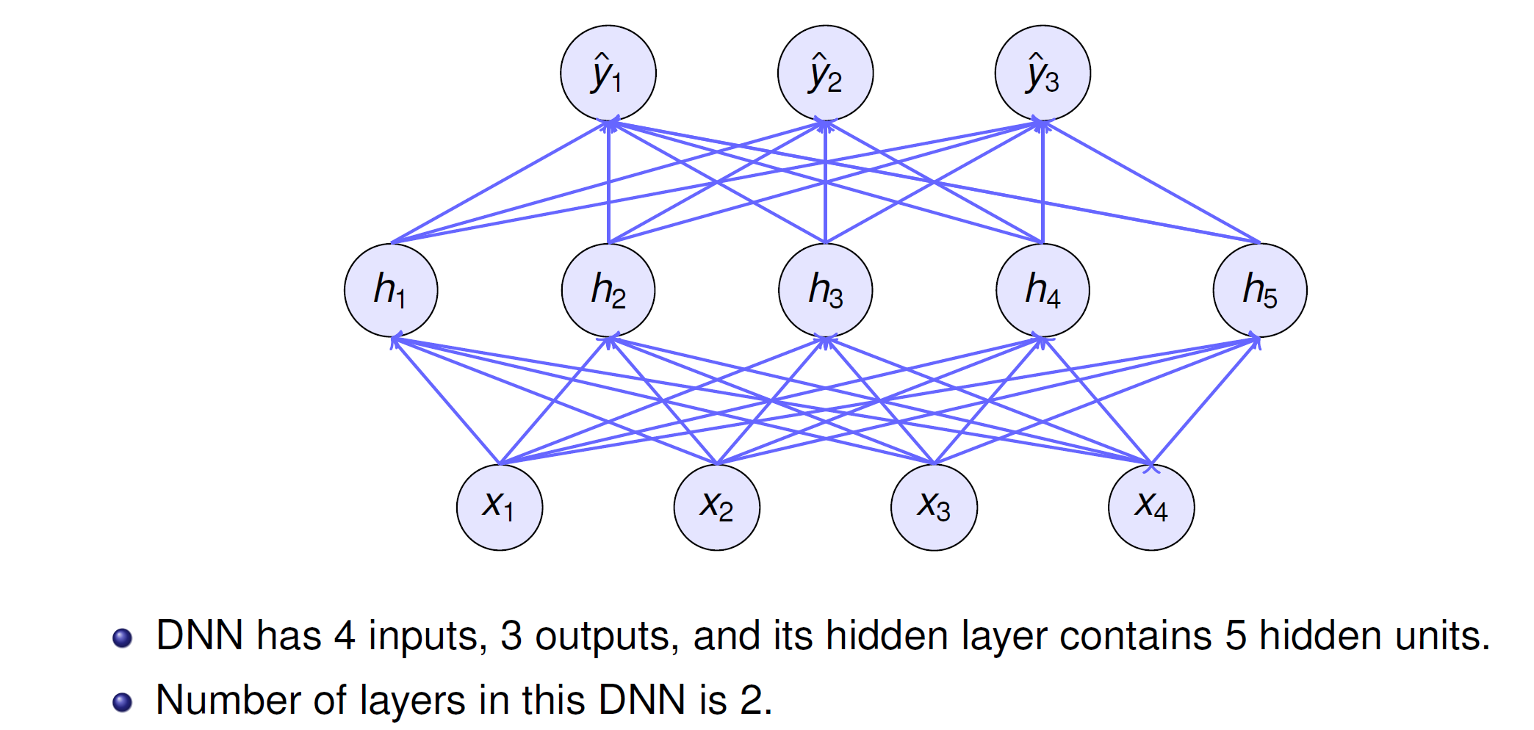
DNN Architecture

Slide 38
Computation Graph – Binary Classification
Forward Pass:
z = w ^{T}X + b
a = yˆ = σ(z)
L(a, y ) = − [y log a + (1 − y ) log(1 − a)]
x₁
w₁
z = w₁x₁ + b
a = σ(z)
L(a, y )
b

Slide 39
DFNN Architecture
Deep Learning

Slide 40
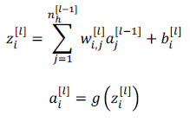
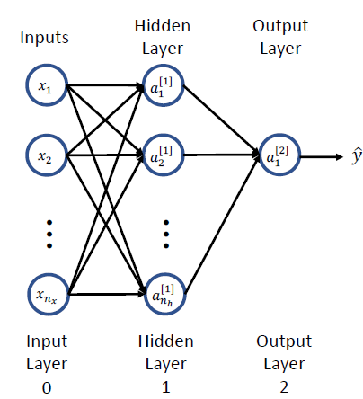
Formalizing Neural Network Construction
Let’s consider a 2-layer Network
Output of one activation unit
Where
𝑔() = activation function
𝑤^{[𝑙]} = weight parameter of input 𝑎^{[𝑙-1]} going to unit 𝑎^{[𝑙]}
𝑛_{𝑥} = number of features (model inputs)
𝑛_{ℎ} = number neurons/units in hidden layer
x_{i} = a_{i}^{[0]}

Slide 42















2-layer NN
Interestingly, neural networks learn their own features!
$$z_{1}^{[1]}$$
$$a_{1}^{[1]}$$
$$x_{0}$$
$$x_{1}$$
$$z_{2}^{[1]}$$
$$a_{2}^{[1]}$$
$$z_{1}^{[2]}$$
$$a_{1}^{[2]}$$
$$\hat{y}$$
$$x_{2}$$
$$z_{3}^{[1]}$$
$$a_{3}^{[1]}$$
Output layer
$$x_{3}$$
Layer 2
Input Layer
(or Layer 0)
$$z_{4}^{[1]}$$
$$a_{4}^{[1]}$$
Hidden layer with 4 neurons
Layer 1

Slide 43

















Example (without vectorization)
$$w_{11}^{[1]}$$
$$z_{1}^{[1]}$$
$$a_{1}^{[1]}$$
$$x_{1}$$
$$w_{11}^{[2]}$$
$$w_{12}^{[1]}$$
$$w_{13}^{[1]}$$
$$b_{1}^{[1]}$$
$$z_{1}^{[2]}$$
$$a_{1}^{[2]}$$
$$\hat{y}$$
$$x_{2}$$
$$w_{21}^{[1]}$$
$$w_{12}^{[2]}$$
$$b_{1}^{[2]}$$
$$w_{22}^{[1]}$$
$$x_{3}$$
$$z_{2}^{[1]}$$
$$a_{2}^{[1]}$$
$$w_{23}^{[1]}$$
$$b_{2}^{[1]}$$

Slide 44
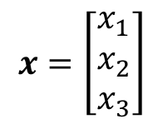

Vectorizing Input and All Variables
To help develop an efficient learning algorithm, let us vectorize (represent in vectors & matrices) the input and the variables involved
$$z_{1}^{[1]}$$
$$a_{1}^{[1]}$$
$$x=\left[\begin{aligned}x_{1} \\ x_{2} \\ x_{3}\end{aligned}\right]$$
$$x_{0}$$
$$x_{1}$$
$$z_{2}^{[1]}$$
$$a_{2}^{[1]}$$
$$x_{2}$$
$$z_{1}^{[2]}$$
$$a_{1}^{[2]}$$
$$\hat{y}$$
$$z_{3}^{[1]}$$
$$a_{3}^{[1]}$$
$$x_{3}$$
Layer 2
Input Layer
(or Layer 0)
$$z_{4}^{[1]}$$
$$a_{4}^{[1]}$$
Layer 1

Slide 45



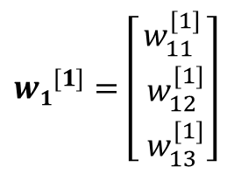

Vectorizing Input and All Variables
$$z_{1}^{[1]}$$
$$a_{1}^{[1]}$$
$${w1}^{[1]}=\left[\begin{aligned}w_{11}^{[1]} \\ { w}_{12}^{[1]} \\ { w}_{13}^{[1]}\end{aligned}\right]$$
$$w_{11}^{[1]}$$
$$x_{0}$$
$$x_{1}$$
$$w_{12}^{[1]}$$
$$z_{2}^{[1]}$$
$$a_{2}^{[1]}$$
$$x_{2}$$
$$z_{1}^{[2]}$$
$$a_{1}^{[2]}$$
$$\hat{y}$$
$$w_{13}^{[1]}$$
$$z_{3}^{[1]}$$
$$a_{3}^{[1]}$$
$$x_{3}$$
Layer 2
Input Layer
(or Layer 0)
$$z_{4}^{[1]}$$
$$a_{4}^{[1]}$$
Layer 1

Slide 46


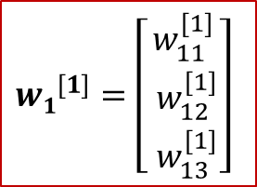
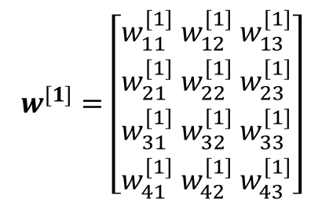


Vectorizing Input and All Variables
$${w1}^{[1]}=\left[\begin{aligned}w_{11}^{[1]} \\ { w}_{12}^{[1]} \\ { w}_{13}^{[1]}\end{aligned}\right]$$
$$w^{[1]}=$$
$$z_{1}^{[1]}$$
$$a_{1}^{[1]}$$
$$x_{0}$$
$$x_{1}$$
$$z_{2}^{[1]}$$
$$a_{2}^{[1]}$$
$$x_{2}$$
$$z_{1}^{[2]}$$
$$a_{1}^{[2]}$$
$$\hat{y}$$
$$z_{3}^{[1]}$$
$$a_{3}^{[1]}$$
$$w^{[1]}=\left[\begin{aligned}w_{11}^{[1]}{ w}_{12}^{[1]}{ w}_{13}^{[1]} \\ w_{21}^{[1]}{ w}_{22}^{[1]}{ w}_{23}^{[1]} \\ w_{31}^{[1]}{ w}_{32}^{[1]}{ w}_{33}^{[1]} \\ w_{41}^{[1]}{ w}_{42}^{[1]}{ w}_{43}^{[1]}\end{aligned}\right]$$
$$x_{3}$$
Layer 2
Input Layer
(or Layer 0)
$$z_{4}^{[1]}$$
$$a_{4}^{[1]}$$
Layer 1
Dimension of $w^{[1]}$= (4, 3)

Slide 47


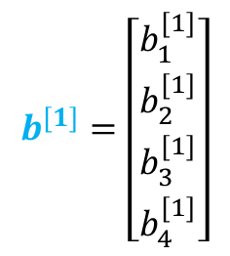



Vectorizing Input and All Variables
$$b^{[1]}=\left[\begin{aligned}b_{1}^{[1]} \\ b_{2}^{[1]} \\ b_{3}^{[1]} \\ b_{4}^{[1]}\end{aligned}\right]$$
$$b_{1}^{[1]}$$
$$z_{1}^{[1]}$$
$$a_{1}^{[1]}$$
$$x_{0}$$
$$b_{2}^{[1]}$$
$$x_{1}$$
$$b_{3}^{[1]}$$
$$z_{2}^{[1]}$$
$$a_{2}^{[1]}$$
$$x_{2}$$
$$z_{1}^{[2]}$$
$$a_{1}^{[2]}$$
$$\hat{y}$$
$$b_{4}^{[1]}$$
$$z_{3}^{[1]}$$
$$a_{3}^{[1]}$$
$$x_{3}$$
Layer 2
Input Layer
(or Layer 0)
$$z_{4}^{[1]}$$
$$a_{4}^{[1]}$$
Layer 1

Slide 48
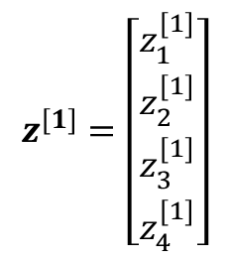

Vectorizing Input and All Variables
$$z^{[1]}=\left[\begin{aligned}z_{1}^{[1]} \\ z_{2}^{[1]} \\ z_{3}^{[1]} \\ z_{4}^{[1]}\end{aligned}\right]$$
$$z_{1}^{[1]}$$
$$a_{1}^{[1]}$$
$$x_{0}$$
$$x_{1}$$
$$z_{2}^{[1]}$$
$$a_{2}^{[1]}$$
$$x_{2}$$
$$z_{1}^{[2]}$$
$$a_{1}^{[2]}$$
$$\hat{y}$$
$$z_{3}^{[1]}$$
$$a_{3}^{[1]}$$
$$x_{3}$$
Layer 2
Input Layer
(or Layer 0)
$$z_{4}^{[1]}$$
$$a_{4}^{[1]}$$
Layer 1

Slide 49
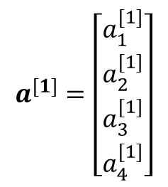

Vectorizing Input and All Variables
$$a^{[1]}=\left[\begin{aligned}a_{1}^{[1]} \\ a_{2}^{[1]} \\ a_{3}^{[1]} \\ a_{4}^{[1]}\end{aligned}\right]$$
$$z_{1}^{[1]}$$
$$a_{1}^{[1]}$$
$$x_{0}$$
$$x_{1}$$
$$z_{2}^{[1]}$$
$$a_{2}^{[1]}$$
$$x_{2}$$
$$z_{1}^{[2]}$$
$$a_{1}^{[2]}$$
$$\hat{y}$$
$$z_{3}^{[1]}$$
$$a_{3}^{[1]}$$
$$x_{3}$$
Layer 2
Input Layer
(or Layer 0)
$$z_{4}^{[1]}$$
$$a_{4}^{[1]}$$
Layer 1

Slide 50
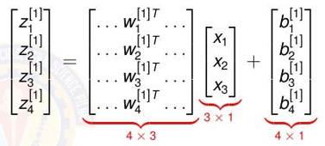
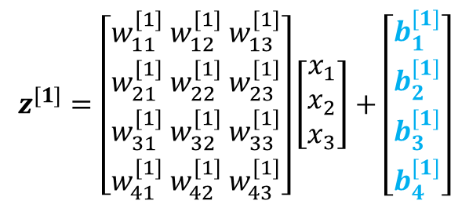


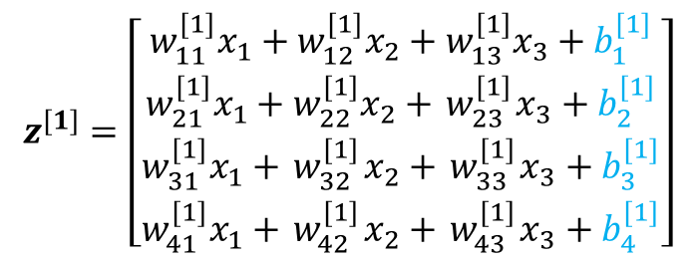
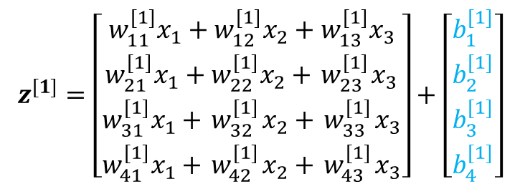
Vectorizing Input and All Variables
$$z^{[1]}=w^{[1]}x+b^{[1]}$$
$$z_{1}^{[1]}$$
$$a_{1}^{[1]}$$
$$z^{[1]}=\left[\begin{aligned}w_{11}^{[1]}{ w}_{12}^{[1]}{ w}_{13}^{[1]} \\ w_{21}^{[1]}{ w}_{22}^{[1]}{ w}_{23}^{[1]} \\ w_{31}^{[1]}{ w}_{32}^{[1]}{ w}_{33}^{[1]} \\ w_{41}^{[1]}{ w}_{42}^{[1]}{ w}_{43}^{[1]}\end{aligned}\right]\left[\begin{aligned}x_{1} \\ x_{2} \\ x_{3}\end{aligned}\right]+\left[\begin{aligned}b_{1}^{[1]} \\ b_{2}^{[1]} \\ b_{3}^{[1]} \\ b_{4}^{[1]}\end{aligned}\right]$$
$$x_{0}$$
$$x_{1}$$
$$z_{2}^{[1]}$$
$$a_{2}^{[1]}$$
$$x_{2}$$
$$z_{1}^{[2]}$$
$$a_{1}^{[2]}$$
$$\hat{y}$$
$$z_{3}^{[1]}$$
$$a_{3}^{[1]}$$
$$x_{3}$$
Layer 2
$$z^{[1]}=\left[\begin{aligned}w_{11}^{[1]}x_{1}+w_{12}^{[1]}x_{2}+w_{13}^{[1]}x_{3} \\ w_{21}^{[1]}{x_{1}+w}_{22}^{[1]}x_{2}+{ w}_{23}^{[1]}x_{3} \\ w_{31}^{[1]}x_{1}+{ w}_{32}^{[1]}x_{2}+{ w}_{33}^{[1]}x_{3} \\ w_{41}^{[1]}x_{1}+{ w}_{42}^{[1]}x_{2}+{ w}_{43}^{[1]}x_{3}\end{aligned}\right]+\left[\begin{aligned}b_{1}^{[1]} \\ b_{2}^{[1]} \\ b_{3}^{[1]} \\ b_{4}^{[1]}\end{aligned}\right]$$
Input Layer
(or Layer 0)
$$z_{4}^{[1]}$$
$$a_{4}^{[1]}$$
Layer 1
In matrix form
$$z^{[1]}=\left[\begin{aligned}w_{11}^{[1]}x_{1}+w_{12}^{[1]}x_{2}+w_{13}^{[1]}x_{3}+b_{1}^{[1]} \\ w_{21}^{[1]}{x_{1}+w}_{22}^{[1]}x_{2}+{ w}_{23}^{[1]}x_{3}+b_{2}^{[1]} \\ w_{31}^{[1]}x_{1}+{ w}_{32}^{[1]}x_{2}+{ w}_{33}^{[1]}x_{3}+b_{3}^{[1]} \\ w_{41}^{[1]}x_{1}+{ w}_{42}^{[1]}x_{2}+{ w}_{43}^{[1]}x_{3}+b_{4}^{[1]}\end{aligned}\right]$$

Slide 51
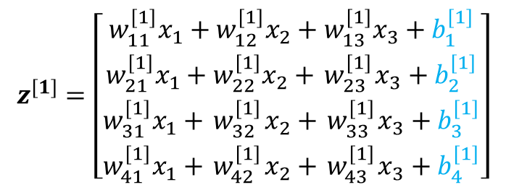




Vectorizing Input and All Variables
$$z_{1}^{[1]}$$
$$a_{1}^{[1]}$$
$$x_{0}$$
$$x_{1}$$
$$z_{2}^{[1]}$$
$$a_{2}^{[1]}$$
$$x_{2}$$
$$z_{1}^{[2]}$$
$$a_{1}^{[2]}$$
$$\hat{y}$$
$a^{[1]}=σ(z^{[1]}$)
$$z_{3}^{[1]}$$
$$a_{3}^{[1]}$$
$$x_{3}$$
Layer 2
Input Layer
(or Layer 0)
$$z_{4}^{[1]}$$
$$a_{4}^{[1]}$$
$$z^{[1]}=w^{[1]}x+b^{[1]}$$
Layer 1
$$z^{[1]}=\left[\begin{aligned}w_{11}^{[1]}x_{1}+w_{12}^{[1]}x_{2}+w_{13}^{[1]}x_{3}+b_{1}^{[1]} \\ w_{21}^{[1]}{x_{1}+w}_{22}^{[1]}x_{2}+{ w}_{23}^{[1]}x_{3}+b_{2}^{[1]} \\ w_{31}^{[1]}x_{1}+{ w}_{32}^{[1]}x_{2}+{ w}_{33}^{[1]}x_{3}+b_{3}^{[1]} \\ w_{41}^{[1]}x_{1}+{ w}_{42}^{[1]}x_{2}+{ w}_{43}^{[1]}x_{3}+b_{4}^{[1]}\end{aligned}\right]$$
$${(z}_{1}^{[1]})$$
$${{−→a}_{1}^{[1]}=σ(z}_{1}^{[1]})$$

Slide 52














Vectorizing Input and All Variables
$$b^{[2]}=\left[b_{1}^{[2]}\right]$$
$$z_{1}^{[1]}$$
$$a_{1}^{[1]}$$
$${w1}^{[2]}=\left[\begin{aligned}w_{11}^{[2]} \\ { w}_{12}^{[2]} \\ { w}_{13}^{[2]} \\ { w}_{14}^{[2]}\end{aligned}\right]$$
$$x_{0}$$
$$w_{11}^{[2]}$$
$$x_{1}$$
$$z_{2}^{[1]}$$
$$a_{2}^{[1]}$$
$${ w}_{12}^{[2]}$$
$$x_{2}$$
$${ w}_{13}^{[2]}$$
$$z_{1}^{[2]}$$
$$a_{1}^{[2]}$$
$$\hat{y}$$
$$z_{3}^{[1]}$$
$$a_{3}^{[1]}$$
$${ w}_{14}^{[2]}$$
$$x_{3}$$
$$z_{4}^{[1]}$$
$$a_{4}^{[1]}$$
$$w^{[2]}=\left[……{ w1}^{\left[2\right]} ……\right]$$
$$w^{[2]}=\left[w_{11}^{[2]}{ w}_{12}^{[2]}{ w}_{13 }^{[2]}{ w}_{14}^{[2]}\right]$$
$$z^{[2]}=\left[z_{1}^{[2]}\right]$$
$$a^{[2]}=\left[a_{1}^{[2]}\right]$$
Dimension of${ w}^{[2]}$= (1, 4)

Slide 53
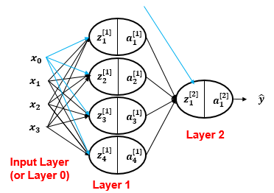

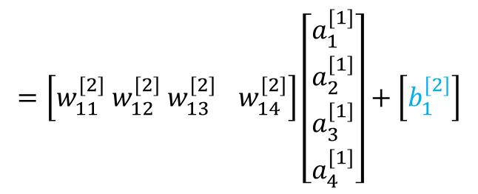




Vectorizing Input and All Variables
$a^{[2]}=σ(z^{[2]}$)
$$z^{[2]}=w^{[2]}x+b^{[2]}$$
$$=w^{[2]}a^{[1]}+b^{[2]}$$
$$=\left[w_{11}^{[2]}{ w}_{12}^{[2]}{ w}_{13 }^{[2]}{ w}_{14}^{[2]}\right]\left[\begin{aligned}a_{1}^{[1]} \\ a_{2}^{[1]} \\ a_{3}^{[1]} \\ a_{4}^{[1]}\end{aligned}\right]+\left[b_{1}^{[2]}\right]$$
$$=\left[w_{11}^{[2]}a_{1}^{[1]}+{ w}_{12}^{[2]}a_{2}^{[1]}+{ w}_{13}^{[2]}a_{3}^{[1]}+{ w}_{14}^{[2]}a_{4}^{[1]}\right]+\left[b_{1}^{[2]}\right]$$
$${a_{1}^{[2]}=σ(z}_{1}^{[2]})$$
$${a_{1}^{[2]}=σ(z}_{1}^{[2]})$$

Slide 54




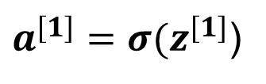

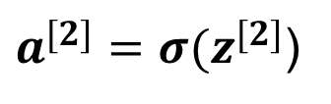
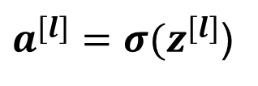
Vectorizing Input and All Variables
$$z_{1}^{[1]}$$
$$a_{1}^{[1]}$$
Forward propagation equations
$${x=a}^{[0]}$$
$$x_{1}$$
$$z_{2}^{[1]}$$
$$a_{2}^{[1]}$$
$$x_{2}$$
$$z_{1}^{[2]}$$
$$a_{1}^{[2]}$$
$$\hat{y}$$
$$x_{3}$$
$$z_{3}^{[1]}$$
$$a_{3}^{[1]}$$
$$z^{[1]}=w^{[1]}x+b^{[1]}$$
Layer 2
Input Layer
(or Layer 0)
$$z_{4}^{[1]}$$
$$a_{4}^{[1]}$$
$a^{[1]}=σ(z^{[1]}$)
Layer 1
$$z^{[2]}=w^{[2]}a^{[1]}+b^{[2]}$$
$a^{[2]}=σ(z^{[2]}$)
For l^{th} layer
But, this assumes only 1 training example!
$$z^{[l]}=w^{[l]}a^{\left[l−1\right]}+b^{[l]}$$
$a^{[l]}=σ(z^{[l]}$)

Slide 55
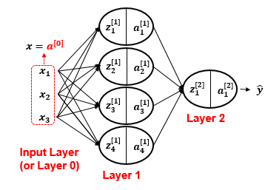
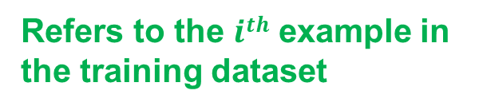




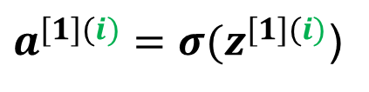
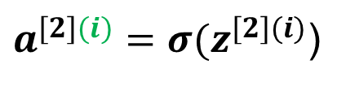
Vectorizing Input and All Variables
Assuming $m$ examples
$$for i=1 to m:$$
$$z^{[1](i)}=w^{[1] }a^{[0](i)}+b^{[1]}$$
$a^{[1](i)}=σ(z^{[1](i)}$)
$$z^{[2](i)}=w^{\left[2\right]}a^{[1](i)}+b^{[2]}$$
$a^{[2](i)}=σ(z^{[2](i)}$)
Refers to the $ith$ example in the training dataset

Slide 56
Vectorizing Input and All Variables
Assuming m examples
But, loops in general slow down programs; hence, it is better to further vectorize the implementation in order to avoid any loop, whenever possible

Slide 57





Vectorizing Input and All Variables
x$=\left[\begin{aligned}x_{1} \\ x_{2} \\ x_{3}\end{aligned}\right]$
Assuming $m$ examples
$$X=\left[\begin{matrix}| & | \\ \begin{aligned}X(1) \\ |\end{aligned} & \begin{aligned}X(2) \\ |\end{aligned}\end{matrix} \begin{matrix} & | \\ \begin{aligned}… \\ \end{aligned} & \begin{aligned}X(m) \\ |\end{aligned}\end{matrix}\right]$$
$$X=\left[\begin{matrix}x_{1}^{(1)} & x_{1}^{(2)} \\ \begin{aligned}x_{2}^{(1)} \\ x_{3}^{(1)}\end{aligned} & \begin{aligned}x_{2}^{(2)} \\ x_{3}^{(2)}\end{aligned}\end{matrix} \begin{matrix} & x_{1}^{(m)} \\ \begin{aligned}… \\ \end{aligned} & \begin{aligned}x_{2}^{(m)} \\ x_{3}^{(m)}\end{aligned}\end{matrix}\right]$$
This vector represents the first example in the training dataset
If we denote $x$ as $a^{\left[0\right]}$
No. of features=n_{x} = 3
$$X=A^{[0]} =\left[\begin{matrix}a_{1}^{[0](1)} & a_{1}^{[0](2)} \\ \begin{aligned}a_{2}^{[0](1)} \\ a_{3}^{[0](1)}\end{aligned} & \begin{aligned}a_{2}^{[0](2)} \\ a_{3}^{[0](2)}\end{aligned}\end{matrix} \begin{matrix} & a_{1}^{[0](m)} \\ \begin{aligned}… \\ \end{aligned} & \begin{aligned}a_{2}^{[0](m)} \\ a_{3}^{[0](m)}\end{aligned}\end{matrix}\right]$$
A^{[0]} shape =(n_{x}, m)

Slide 58




Vectorizing Input and All Variables
Assuming $m$ examples
$$Z[1]=\left[\begin{matrix}| & | \\ \begin{aligned}Z[1](1) \\ |\end{aligned} & \begin{aligned}Z[2](2) \\ |\end{aligned}\end{matrix} \begin{matrix} & | \\ \begin{aligned}… \\ \end{aligned} & \begin{aligned}Z[1](m) \\ |\end{aligned}\end{matrix}\right]$$
No. of hidden units at layer 1 =n_{h} = 4
Z^{[1]} shape =(n_{h},m)
$$Z^{[1]}=w^{[1]}A^{[0]}+b^{[1]}$$
$$Z^{[1]}=\left[\begin{aligned}z_{1}^{[1](1)} \\ z_{2}^{[1](1)} \\ z_{3}^{[1](1)} \\ z_{4}^{[1](1)}\end{aligned} \begin{aligned}z_{1}^{[1](2)} \\ z_{2}^{[1](2)} \\ z_{3}^{[1](2)} \\ z_{4}^{[1](2)}\end{aligned} \begin{aligned} \\ \\ … \\ \end{aligned} \begin{aligned}z_{1}^{[1](m)} \\ z_{2}^{[1](m)} \\ z_{3}^{[1](m)} \\ z_{4}^{[1](m)}\end{aligned}\right]$$
$$Z^{[1]}={matmul(w}^{[1]},A^{[0]})+b^{[1]}$$

Slide 59



Vectorizing Input and All Variables
Assuming $m$ examples
$$A[1]=\left[\begin{matrix}| & | \\ \begin{aligned}A[1](1) \\ |\end{aligned} & \begin{aligned}A[2](2) \\ |\end{aligned}\end{matrix} \begin{matrix} & | \\ \begin{aligned}… \\ \end{aligned} & \begin{aligned}A[1](m) \\ |\end{aligned}\end{matrix}\right]$$
A^{[1]} shape =(n_{h},m)
$$A^{[1]}=\left[\begin{aligned}a_{1}^{[1](1)} \\ a_{2}^{[1](1)} \\ a_{3}^{[1](1)} \\ a_{4}^{[1](1)}\end{aligned} \begin{aligned}a_{1}^{[1](2)} \\ a_{2}^{[1](2)} \\ a_{3}^{[1](2)} \\ a_{4}^{[1](2)}\end{aligned} \begin{aligned} \\ \\ … \\ \end{aligned} \begin{aligned}a_{1}^{[1](m)} \\ a_{2}^{[1](m)} \\ a_{3}^{[1](m)} \\ a_{4}^{[1](m)}\end{aligned}\right]$$
$A^{[1]}=σ(Z^{[1]}$)

Slide 60




Vectorizing Input and All Variables
Assuming $m$ examples
Z^{[2]} shape =(1,m)
$$Z^{[2]}=\left[z_{1}^{[2](1)} z_{1}^{[2](2)}… { z}_{1}^{[2](m)}\right]$$
$$Z^{[2]}=w^{[2]}A^{[1]}+b^{[2]}$$
A^{[2]} shape =(1,m)
$$A^{[2]}=\left[a_{1}^{[2](1)} a_{1}^{[2](2)}… { a}_{1}^{[2](m)}\right]$$
$A^{[2]}=σ(Z^{[2]}$)

Slide 61









Forward propagation equations
No Explicit Loop!
$$for i=1 to n:$$
$$Z^{[1]}=w^{[1]}A^{[0]}+b^{[1]}$$
$$z^{[1](i)}=w^{[1]}a^{[0](i)}+b^{[1]}$$
$a^{[1](i)}=σ(z^{[1](i)}$)
$A^{[1]}=σ(Z^{[1]}$)
$$z^{[2](i)}=w^{[2]}a^{[1](i)}+b^{[2]}$$
$$Z^{[2]}=w^{[2]}A^{[1]}+b^{[2]}$$
$a^{[2](i)}=σ(z^{[2](i)}$)
$A^{[2]}=σ(Z^{[2]}$)
Before Vectorization
After Vectorization

Slide 62

Matrix dimensions

Slide 63

Dimensions for 1 training example:
a^{[0]} shape =(2,)
w^{[3]} shape =(3,4)
b^{[3]} shape =(3,)
z^{[3]} shape =(3,)
ŷ = a^{[3]} shape =(3,)
(𝒏_{𝒉}^{[l]}, 𝒏_{𝒙})
(𝒏_{𝒉}^{[l]}, )
(𝒏_{𝒉}^{[l]}, )
(𝒏_{𝒉}^{[l]}, )
w^{[1]} shape =(5,2)
b^{[1]} shape =(5,)
z^{[1]} shape =(5,)
a^{[1]} shape =(5,)
w^{[2]} shape =(4,5)
b^{[2]} shape =(4,)
z^{[2]} shape =(4,)
a^{[2]} shape =(4,)

Slide 64

Total Parameters in Network
Deep Learning
21 / 67

Slide 65

Forward Pass Algorithm
Deep Learning

Slide 66

Layer-wise Computation
Deep Learning

Slide 67

Forward Pass: Vectorized for Mini-Batch
1B refers to a column vector of ones with a dimension of B
Deep Learning

Slide 69






Example for broadcasting for bias
e.g mini-batch of 3 samples (B=3) through a layer that has 2 neurons ( n_{l}=2 )
Suppose result of matrix multiplication {H(l-1) . W} for 3 samples is
b(l): bias vector for 2 neurons, typically a 2 X 1 vector
B = batch size = 3 → column vector of ones of size B X 1

Slide 71
Forward Step
Given some [initial] values for the parameters, we can compute the forward pass, layer by layer.
Forward pass is basically 𝐿 matrix multiplications, each followed by an activation function.
Matrix multiplication can be done efficiently with GPUs.
Therefore, forward pass is somewhat fast.
Complexity of forward pass, linear of depth 𝑂(𝐿) .

Slide 72

Loss Computation
Deep Learning

Slide 73

Mini-Batch Stochastic Gradient Descent
Core idea: Update parameters using gradients from mini-batches Update rule for layer l:
Deep Learning

Slide 74

Training Algorithm: Mini-Batch SGD
Deep Learning

Slide 76
Example
Let’s say you have 10,000 images to train on.
With mini‑batch size = 64, your training steps per epoch:
10,000 ÷ 64 ≈ 157 steps
Each step:
Look at 64 images
Compute gradients
Update weights

